Slide 1
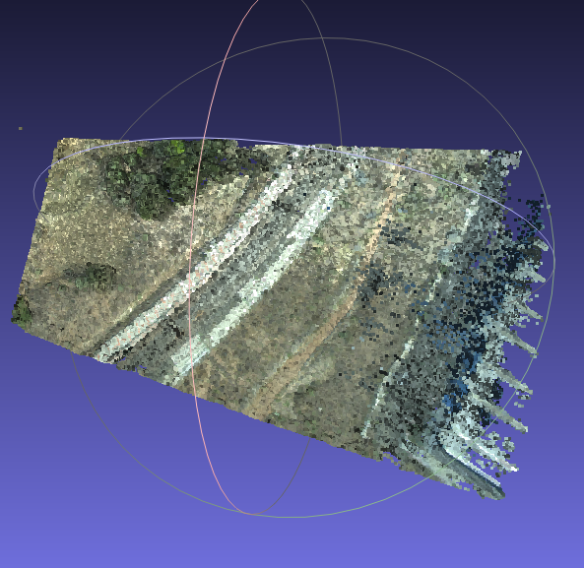
Images
Feature Extraction
Initialization
Feature Matching
Triangulation
Outlier Filtering
Bundle
Adjustment
.
.
.
Inlier Filtering
Stitched-Image
Reconstruction
Stitching Module
Camera Extrinsics

